Slide 1

Java script

Slide 2
Introduction
Java script was designed to add interactivity to HTML pages.
Java script is a scripting language.
A scripting language is a light weight programming language.
Java script is usually embedded directly into HTML pages.
Java script is an interpreted language (means that scripts execute without preliminary compilation)
Everyone can use java script without purchasing a license.

Slide 3
Java script can change HTML Content:
One of many Java script HTML Methods is getElementById().
Eg: <!DOCTYPE html>
<html>
<body>
<h2>What Can JavaScript Do?</h2>
<p id="demo">JavaScript can change HTML content.</p>
<button type="button" onclick='document.getElementById("demo").innerHTML = "Hello JavaScript!"'>Click Me!</button>
</body>
</html>
Note: JavaScript accepts both double and single quotes:

Slide 4
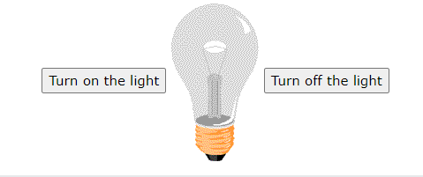
Java script can change HTML attribute values:
In this example java script changes the value of the src (source) attribute of an <img> tag:
Java script can change HTML styles(css):
Eg: document.getElementById("demo").style.fontSize = "35px";
Java script can hide html elements:
Eg: document.getElementById("demo").style.display = "none";
Java script can show HTML elements:
Eg: document.getElementById("demo").style. Display = "block";

Slide 5
3 places to put JS code
Between the <body> tag of html.
Between the <head> tag of the html.
In .js file (external java script).
Eg(1): <html>
<head></head>
<body>
<h1>My web page</h1>
<p id="demo"> this is the paragraph of identify the js integrated into the body tag</p>
<script type="text/javascript">
document.getElementById("demo").innerHTML= "successfully integrated the JavaScript";
</script>
</body>
</html>

Slide 6
Eg(2): <html>
<head>
<script type="text/javascript">
function myfunction()
{
document.getElementById("demo").innerHTML="this is the message of js intgration in head tag";
}
</script>
</head>
<body>
<h2>My web page</h2>
<p id="demo"> this is a paragraph</p>
<button type="button" onclick="myfunction()">Try it!</button>
</body>
</html>

Slide 7
Eg (3): body.html
<html><body> <h2>Demo External JavaScript</h2> <p id="demo">A Paragraph.</p> <button type="button" onclick="myFunction()">Try it</button> <p>This example links to "myScript.js".</p>
<p>(myFunction is stored in "myScript.js")</p> <script src="myscript.js"></script> </body>
</html>
myscript.js
function myFunction() {
document.getElementById("demo").innerHTML = "Paragraph changed.";
}

Slide 8
Js Display possibilities
JavaScript can "display" data in different ways:
Writing into an HTML element,using innerHTML.
Writing into the HTML output using document.write().
Writing into an alert box, using window.alert().
Writing into an alert box, using console.log().

Slide 9
Js statements
What is Java script programs:
A computer program is a list of "instructions" to be "executed" by a computer. In a programming language, these programming instructions are called statements. A JavaScript program is a list of programming statements.
JavaScript statements are composed of: Values, Operators, Expressions, Keywords, and Comments.
Semicolons separate JavaScript statements.
Eg: let a, b, c; // Declare 3 variables a = 5; // Assign the value 5 to a b = 6; // Assign the value 6 to b c = a + b; // Assign the sum of a and b to c

Slide 10
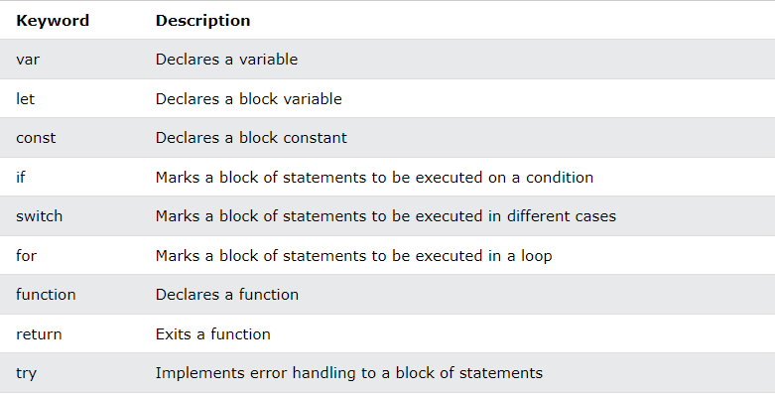
JS Keywords

Slide 11
JS Operators
There are different types of JavaScript operators:
Arithmetic Operators
Assignment Operators
Comparison Operators
String Operators
Logical Operators
Bitwise Operators
Ternary Operators
Type Operators

Slide 12
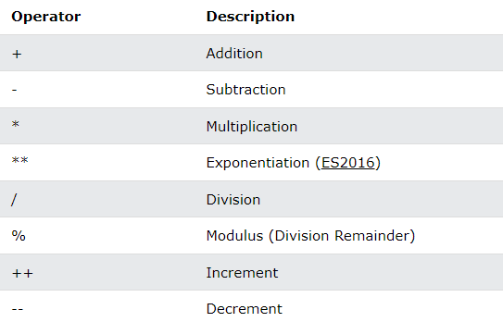
Arithmetic operators

Slide 13
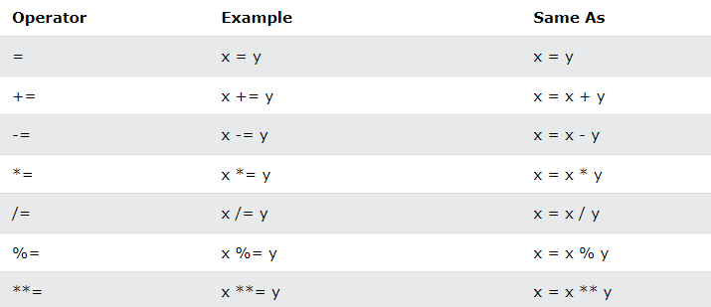
Assignment operators

Slide 14
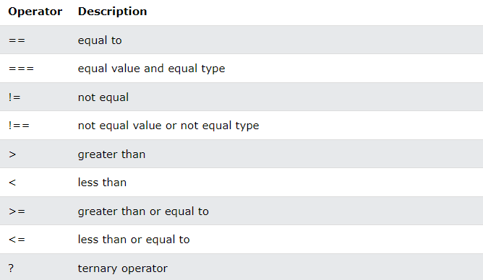
Comparison operators

Slide 15
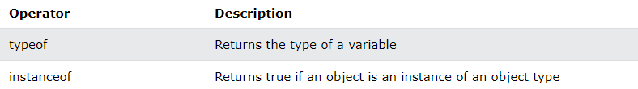
Type operators

Slide 16
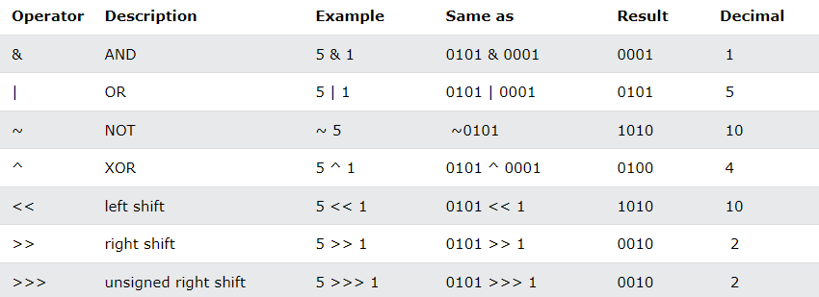
Bitwise operators

Slide 17
Js data types
String
Number
Bigint
Boolean
Undefined
Null
Symbol
Object
Object
Array
Date

Slide 18
Js function
A JavaScript function is a block of code designed to perform a particular task.
A JavaScript function is executed when "something" invokes it (calls it).
Eg: <p id="demo"></p>
<script>
function myFunction(p1, p2) {
} return p1 * p2;
let result = myFunction(5, 3);
document.getElementById("demo").innerHTML = result;
</script>

Slide 19
A java script function is defined with the function keyword, followed by a name, followed by parentheses().
Function name can contain letters, digits, underscores, and dollar signs.
The parentheses may include parameter names separated by commas: (parameter1,parameter2,…)
The code to be executed, by the function, is placed curly brackets:{}
Eg: function name(parameter1, parameter2, parameter3) { // code to be executed }
Function parameters are listed inside the parentheses(() in the function definition.
Function arguments are the values received by the function when it is invoked.
Inside the function, the arguments (parameters) behave as local variables.

Slide 20
Function return
When java script reaches a return statement, the function will stop executing.
If the function was invoked from a statement, java script will “return” to execute the code after the invoking statement.
functions often compute a return value. The return value is “returned” back to the “caller”.
Eg: <p id="demo"></p>
<script>
let x = myFunction(4, 3);
document.getElementById("demo").innerHTML = x;
function myFunction(a, b) {
return a * b;
} </script>

Slide 21
JS strings
It simply stores a series of characters, strings are written with quotes.
Eg: Let text = “good morning”
String can also be defned as the object with the keyword “new”
Eg: let y = new String("John");
js objects cannot be compared

Slide 22
Js string methods
String length:
The length property returns the length of a string.
Eg: let text = "ABCDEFGHIJKLMNOPQRSTUVWXYZ"; let length = text.length;
Extracting string characters:
There are 4 methods for extracting string characters:
The at(position) method
The charAt(position) method
The charCodeAt(position) method
Using property access [] like in arrays

Slide 23
charAt() method
The charAt() method returs the character at a specified index (position) in a string.
Eg: let text = "HELLO WORLD"; let char = text.charAt(0);
charCodeAt() method
The charCodeAt() method returns the code of the character at a specified index in a string. The method returns a UTF-16 code (an integer between 0 and 65535).
Eg: let text = "HELLO WORLD"; let char = text.charCodeAt(0);
3. at() method
The at() method returns the character at a specified index (position) in a string. The at() method returns same as the charAt().

Slide 24
Eg: const name= "W3Schools"; let letter = name.at(2);
Using property access [] like in arrays
Eg: let text = "HELLO WORLD"; let char = text[0];

Slide 25
Extracting string parts
There are 3 methods for extracting a part of a string:
Slice(start, end)
Substring(start, end)
Substr(start, length)
String slice()
Slice() extracts a part of a string and returns the extracted part in a new string.
The method takes 2 parameters: start position, and end position .
Eg: let text = "Apple, Banana, Kiwi"; let part = text.slice(7, 13);

Slide 26
String substring()
Substring() is similar to slice().
Eg: let str = "Apple, Banana, Kiwi"; let part = str.substring(7, 13);
String substr()
Substr() is similar to slice()
The difference is that the second parameter specifies the length of the extracted part.
Eg: let str = "Apple, Banana, Kiwi"; let part = str.substring(7, 6);

Slide 27
Converting to upper and lower case
A string is converted to upper case with toUpperCase()
A string is converted to lower case with toLowerCase()
Eg: let text1 = "Hello World!"; let text2 = text1.toUpperCase();
Concatenation
Concat() joins two or more strings.
The concat() method can be used instead of the plus operator.
Eg: text = "Hello" + " " + "World!"; text = "Hello".concat(" ", "World!");
let text1 = "Hello"; let text2 = "World"; let text3 = text1.concat(" ", text2);

Slide 28
String Trim
The trim() method removes whitespaces from both sides of a string.
Eg: let text1 = " Hello World! "; let text2 = text1.trim();
trimStart()
The trimStart() method works like trim(), but removes whitespace only from the start of a string.
Eg: let text1 = " Hello World! "; let text2 = text1.trimStart();
trimEnd()
The trimEnd() method works like trim(), but removes whitespaces only from the end of a string.

Slide 29
String repeat()
The repeat() method returns a string with a number of copies of a string.
The repeat() method returns a new string.
The repeat() method does not change the original string().
Eg: let text = "Hello world!"; let result = text.repeat(2);
Replacing String Content
The replace() method replaces a specified value with another value in a string:
Eg: let text = "Please visit Microsoft!"; let newText = text.replace("Microsoft", “google");

Slide 30
Converting a string to an Array
A string can be converted to an array with the split() method:
Eg: text.split(",") // Split on commas text.split(" ") // Split on spaces text.split("|") // Split on pipe

Slide 31
String Search
String indexOf():
The indexOf() method returns the index (position) of the first occurrence of a string in a string, or it returns -1 if the string is not found:
Eg: let text = "Please locate where 'locate' occurs!"; let index = text.indexOf("locate");
String lastIndexOf():
The lastIndexOf() method returns the index of the last occurrence of a specified text in a string.
Eg: let text = "Please locate where 'locate' occurs!"; let index = text.lastIndexOf("locate");
Both indexOf(), and lastIndexof() return -1 if the text is not found:

Slide 32
Eg: let text = "Please locate where 'locate' occurs!"; let index = text.lastIndexOf("John");
Both methods accept a second parameter as the starting position for the search:
Eg: let text = "Please locate where 'locate' occurs!"; let index = text.indexOf("locate", 15);
The lastIndexOf() methods searches backwards (from the end to the beginning), meaning: if the second parameter is 15, the search starts at position 15, and searchesto the beginning of the string.
String search():
The search() method searches a string for a string (or regular expression) and returns the position of the match:
Eg: let text = "Please locate where 'locate' occurs!"; text.search("locate");

Slide 33
String includes():
The includes() method returns true if a string contains a specified value, otherwise it returns false.
Eg: let text = "Hello world, welcome to the universe."; text.includes("world");
Check if a string includes "world". Start at position 12:
Eg: let text = "Hello world, welcome to the universe."; text.includes("world", 12);
String startsWith():
The startWith() method returns true if a string begins with a specified value. Otherwise it returns false.
Eg: let text = "Hello world, welcome to the universe."; text.startsWith("Hello");

Slide 34
String endsWith():
The endsWith() method returns true if a string ends with a specified value. Otherwise it returns false.
Eg: let text = "John Doe"; text.endsWith("Doe");

Slide 35
Arrays
An array is a special variable, which can hold more than one value.
Syntax: const array_name = [item1, item2, ...];
Eg: const cars = ["Saab", "Volvo", "BMW"];
Accessing array elements:
You access an array element by referring to the index number:
Eg: const cars = ["Saab", "Volvo", "BMW"]; let car = cars[0];
NoTe: Array indexes start with 0. [0] is the first element. [1] is the second element.

Slide 36
Changing an array element:
Eg: const cars = ["Saab", "Volvo", "BMW"]; cars[0] = "Opel";
Converting an array to a string:
The javascript method toString() converts an array to a string of (comma separated) array values.
Eg: const fruits = ["Banana", "Orange", "Apple", "Mango"]; document.getElementById("demo").innerHTML = fruits.toString();
Access the full array:
The full array can be accessed by referring to the array name.
Eg: const cars = ["Saab", "Volvo", "BMW"]; document.getElementById("demo").innerHTML = cars;

Slide 37
Arrays are Objects:
Arrays are a special type of objects. The “typeof” operator in java script returns “object” for arrays.
Array use numbers to access its elements.
Eg: const person = ["John", "Doe", 46];
Objects use names to access its "members“.
Eg: const person = {firstName:"John", lastName:"Doe", age:46};

Slide 38
Array properties and methods
The length property:
The length property of an array returns the length of an array.
Eg: const fruits = ["Banana", "Orange", "Apple", "Mango"]; let length = fruits.length;
Accessing the first array element:
Eg: const fruits = ["Banana", "Orange", "Apple", "Mango"]; let fruit = fruits[0];
Accessing the last array element:
Eg: const fruits = ["Banana", "Orange", "Apple", "Mango"]; let fruit = fruits[fruits.length - 1];

Slide 39
Looping Array element:
One way to loop through an array, is using a for loop:
Eg: const fruits = ["Banana", "Orange", "Apple", "Mango"]; let fLen = fruits.length; let text = "<ul>"; for (let i = 0; i < fLen; i++) { text += "<li>" + fruits[i] + "</li>"; } text += "</ul>";
Using the Array,forEach() function:
Eg: const fruits = ["Banana", "Orange", "Apple", "Mango"]; let text = "<ul>"; fruits.forEach(myFunction); text += "</ul>"; function myFunction(value) { text += "<li>" + value + "</li>";} }

Slide 40
Adding array elements:
The easiest way to add a new element to an array using the push() method:
Eg: const fruits = ["Banana", "Orange", "Apple"]; fruits.push("Lemon"); // Adds a new element (Lemon) to fruits
Now element cam also be added to an array using the length property:
Eg: const fruits = ["Banana", "Orange", "Apple"]; fruits[fruits.length] = "Lemon"; // Adds "Lemon" to fruits
NoTe: Adding elements with high indexes can create undefined "holes" in an array:
Eg: const fruits = ["Banana", "Orange", "Apple"]; fruits[6] = "Lemon"; // Creates undefined "holes" in fruits

Slide 41
Array method
Array at():
Eg: const fruits = ["Banana", "Orange", "Apple", "Mango"]; let fruit = fruits.at(2);
The at() method returns an indexed element from an array.
The at() method returns the same as the [].
Array join():
The join() method also joins all array elements into a string.
It behaves just like toString(), but in addition you can specify the seperator.
Eg: const fruits = ["Banana", "Orange", "Apple", "Mango"]; document.getElementById("demo").innerHTML = fruits.join(" * ");

Slide 42
Popping and pushing:
When you work with arrays, it is easy to remove elements and add new elements.
This is what popping and pushing is:
Popping items out of an array, or pushing items into an array.
Array pop(): method removes the last element from an array:
Eg: const fruits = ["Banana", "Orange", "Apple", "Mango"];
fruits.pop();
The pop() method returns the value that was popped out:
Eg: const fruits = ["Banana", "Orange", "Apple", "Mango"]; let fruit = fruits.pop();

Slide 43
Array push():
The push() method adds a new element to an array (at the end():
Eg: const fruits = ["Banana", "Orange", "Apple", "Mango"]; fruits.push("Kiwi");
The push() method returns the new array length:
Eg: const fruits = ["Banana", "Orange", "Apple", "Mango"]; let length = fruits.push("Kiwi");
Array delete()
Using delete() leaves undefined holes in the array.
Eg: const fruits = ["Banana", "Orange", "Apple", "Mango"]; delete fruits[0];

Slide 44
Array concat():
The concat() method creates a new array by merging existing arrays.
Eg: const myGirls = ["Cecilie", "Lone"]; const myBoys = ["Emil", "Tobias", "Linus"]; const myChildren = myGirls.concat(myBoys);
The concat() method does not change the existing arrays. It always return a new array.
The concat() method can take any number of array arguments.
Eg: const arr1 = ["Cecilie", "Lone"]; const arr2 = ["Emil", "Tobias", "Linus"]; const arr3 = ["Robin", "Morgan"]; const myChildren = arr1.concat(arr2, arr3);
The concat() method can also take strings as arguments:
Eg: const arr1 = ["Emil", "Tobias", "Linus"]; const myChildren = arr1.concat("Peter");

Slide 45
Array search
indexOf() method:
The indexOf() method searches an array for an element value and returns its position.
Eg: const fruits = ["Apple", "Orange", "Apple", "Mango"]; let position = fruits.indexOf("Apple") + 1;
lastIndexOf() method:
lastIndexOf() is the same as the indexOf(), but returns the position of the last occurrence of the specified element.
Eg: const fruits = ["Apple", "Orange", "Apple", "Mango"]; let position = fruits.lastIndexOf("Apple") + 1;
array includes():
This allows us to check if an element is present in an array.
Eg: const fruits = ["Banana", "Orange", "Apple", "Mango"]; fruits.includes("Mango"); // is true

Slide 46
Array sort
sort() method sorts an array alaphabetically:
Eg: const fruits = ["Banana", "Orange", "Apple", "Mango"]; fruits.sort();
reverse() method reverse the elements in an array:
Eg: const fruits = ["Banana", "Orange", "Apple", "Mango"]; fruits.reverse();

Slide 47
Conditional statements
if statement:
The if statement to specify a bock of javascript code to be executed if a condition is true.
Syntax: if (condition) { // block of code to be executed if the condition is true }
else statement:
The else statement to specify a block of code to be executed if the condition is false.
Syntax: if (condition) { // block of code to be executed if the condition is true } else { // block of code to be executed if the condition is false }

Slide 48
else if statement to specify a new condition if the first condition is false.
Syntax: if (condition1) { // block of code to be executed if condition1 is true } else if (condition2 { // block of code to be executed if the condition1 is false and condition2 is true } else { // block of code to be executed if the condition1 is false and condition2 is false }

Slide 49
switch statement:
The switch statement is used to perform different actions based on different conditions.
Syntax: switch(expression) { case x: // code block break; case y: // code block break; default: // code block }

Slide 50
Java script loop
For loop
The for statement creates a loop with 3 optional expressions.
Syntax:
for (expression 1; expression 2; expression 3) {
// code block to be executed
}
Expression 1 is executed (one time) before the execution of the code block.
Expression 2 defines the condition for executing the code block.
Expression 3 is executed (every time) after the code block has been executed.

Slide 51
while loop:
The while loop loops through a code as long as a specified condition is true.
Syntax:
while (condition) {
// code block to be executed
}
do while loop:
The do while loop is a variant of the while loop. This loop will execute the code block once, before checking if the condition is true, then it will repeat the loop as long as the condition is true.
Syntax:
do {
// code block to be executed
}
while (condition);

Slide 52
Java script forms
HTML form validation can be done by JavaScript.
If a form field (fname) is empty, this function alerts a message, and returns false, to prevent the form from being submitted:
Eg: function validateForm() { let x = document.forms["myForm"]["fname"].value; if (x == "") { alert("Name must be filled out"); return false; } }

Slide 53
Validating a number input field:
<script>
function myFunction() {
// Get the value of the input field with id="numb"
let x = document.getElementById("numb").value;
// If x is Not a Number or less than one or greater than 10
let text;
if (isNaN(x) || x < 1 || x > 10) {
text = "Input not valid";
} else {
text = "Input OK";
}
document.getElementById("demo").innerHTML = text;
}
</script>

